Slide 1
IMAGE ENHANCEMENT

Slide 2
Team Members
Shourya Prasad – RA2011047010001
Charanjeet Singh – RA2011047010005
Abhinn Daga – RA2011047010007
Glenn Paul Aby – RA2011047010017
Prateek Uniyal – RA2011047010032

Slide 3
Problem Statement
Since a normal image is not clear and it may not show some useful information or its brightness level seems inappropriate, then to get rid of such problems, we perform image enhancement to get a better and clearer image

Slide 4
Introduction
Image Enhancement is basically improving the interpretability or perception of information in images for human viewers and providing ‘better’ input for other automated image processing techniques. The principal objective of Image Enhancement is to modify attributes of an image to make it more suitable for a given task and a specific observer
With the goal of recovering high-quality image content from its degraded version, image restoration enjoys numerous applications, such as in surveillance, computational photography, medical imaging, and remote sensing. Recently, convolutional neural networks (CNNs) have achieved dramatic improvements over conventional approaches for image restoration task. Existing CNN-based methods typically operate either on full-resolution or on progressively low-resolution representations. In the former case, spatially precise but contextually less robust results are achieved, while in the latter case, semantically reliable but spatially less accurate outputs are generated

Slide 5
LoL Dataset
For MIRNet
The LOL (Low-Light) dataset is a benchmark dataset designed to address the real-world challenge of low-light image enhancement. The LOL dataset is divided into 485 training pairs and 15 testing pairs and contains 500 low-light and normal-light image pairs. The noise in the low-light image was created during the photo-taking procedure. The majority of the photos are of interiors. The photos are all 400×600 pixels in size.

Slide 6
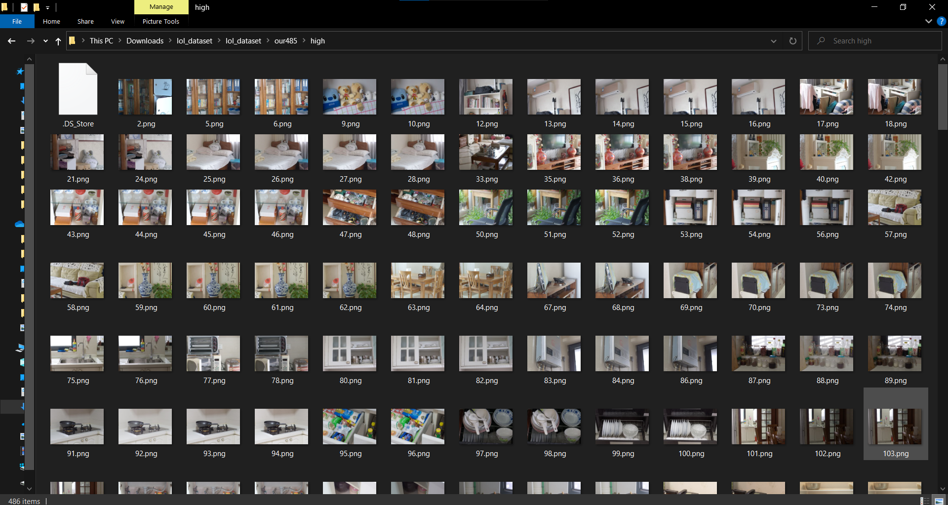
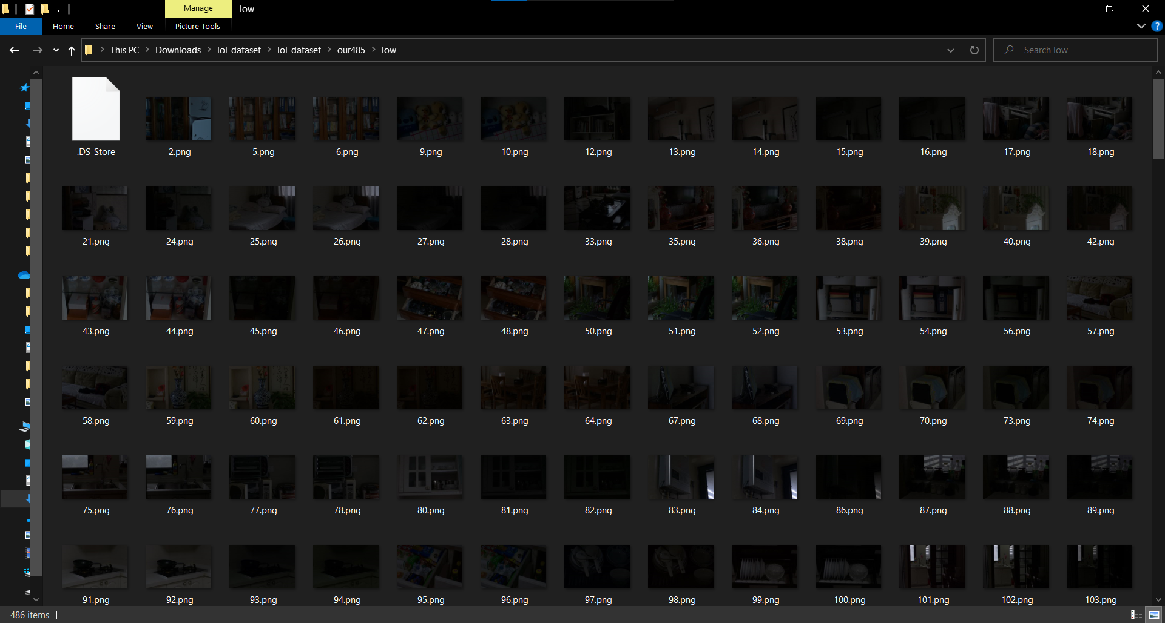
485 training pairs
-high
-low

Slide 7
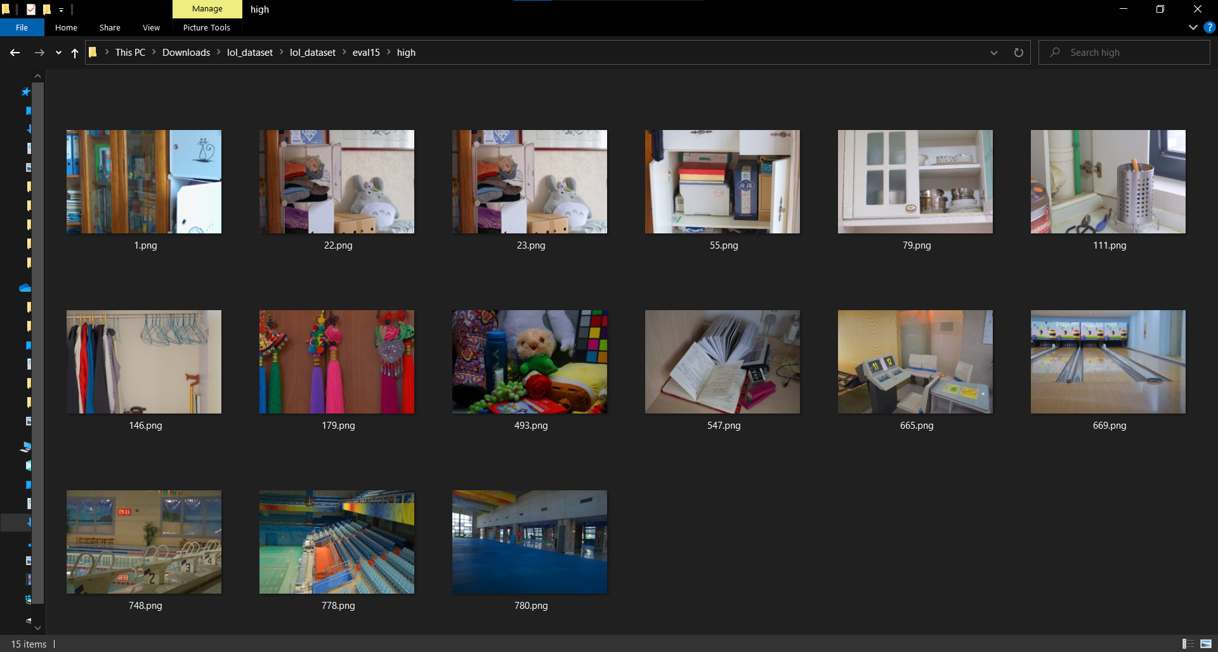
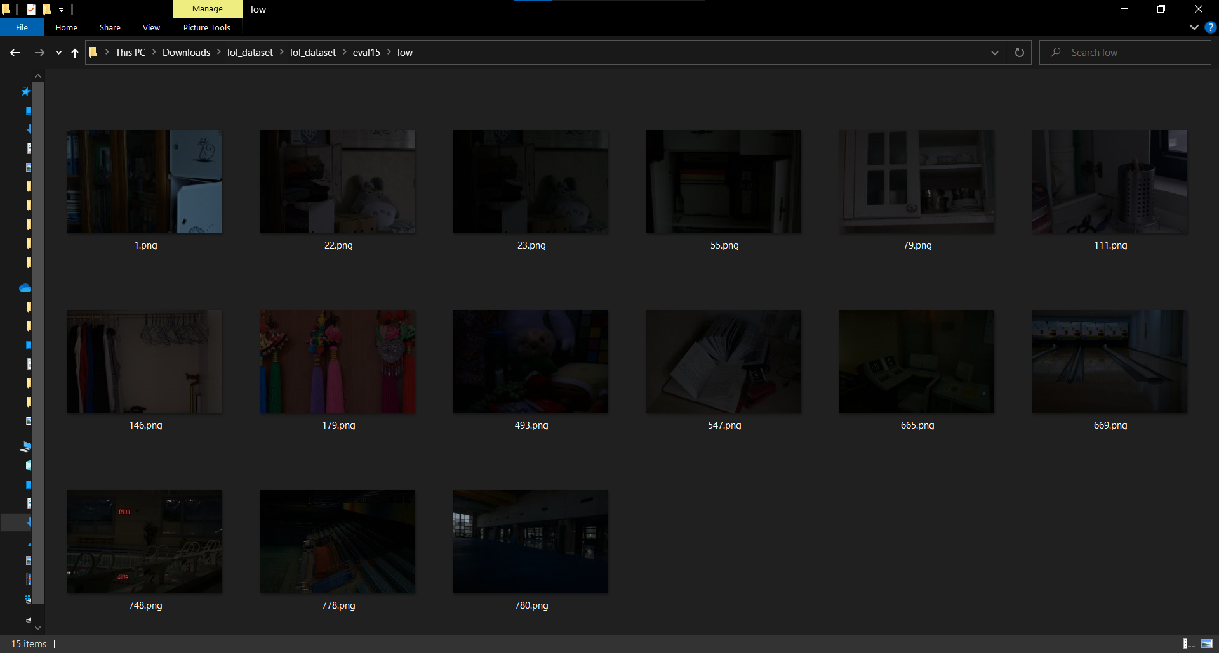
15 testing pairs
-high
-low

Slide 8
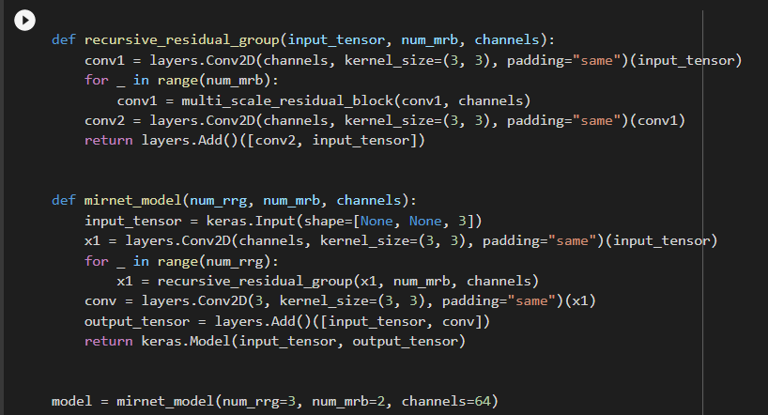
MIRNet model

Slide 9
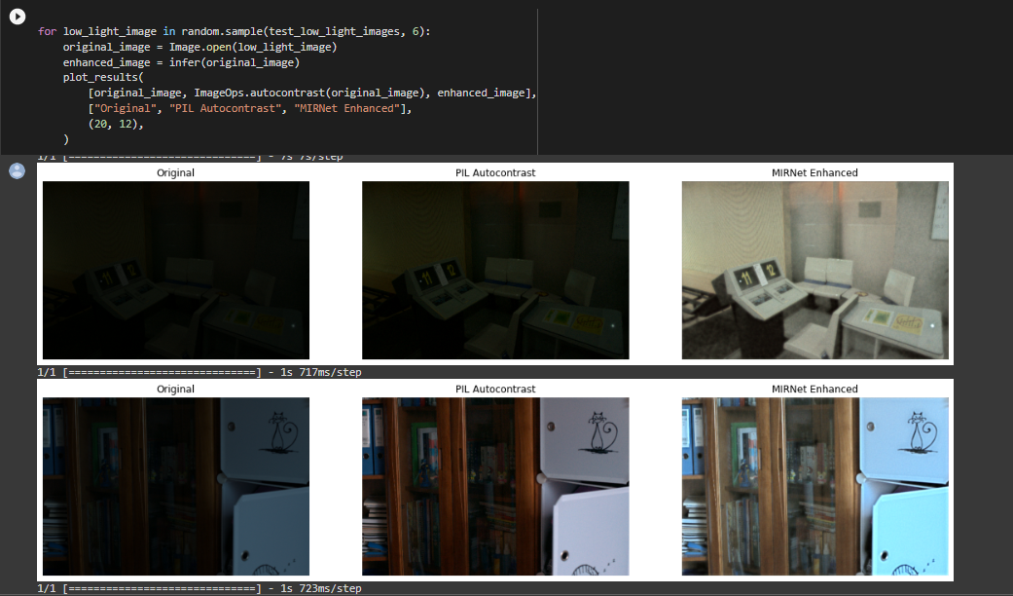
Inference on test image

Slide 10
Dataset for SRGAN
Flickr and Pixabay dataset
dataset is built by forming links between images sharing common metadata from Flickr. Edges are formed between images from the same location, submitted to the same gallery, group, or set, images sharing common tags, images taken by friends, etc.

Slide 11
Models Used
We have used two model - MIRNet and SRGAN
For MIRNet we used the LOL Dataset
For SRGAN we used the Flickr and Pixabay Dataset

Slide 12
The MIRNet presents a novel architecture with the collective goals of maintaining high-resolution representations through the entire network and receiving strong contextual information from the low-resolution representations.
The core of this approach is a multi-scale residual block containing the following key elements:
parallel multi-resolution convolution streams for extracting multi-scale features
information exchange across the multi-resolution streams
spatial and channel attention mechanisms for capturing contextual information
attention based multi-scale feature aggregation.
About MIRNet

Slide 13
the main features of the MIRNet model:
A feature extraction model that computes a complementary set of features across multiple spatial scales, while maintaining the original high-resolution features to preserve precise spatial details.
A regularly repeated mechanism for information exchange, where the features across multi-resolution branches are progressively fused together for improved representation learning.
A new approach to fuse multi-scale features using a selective kernel network that dynamically combines variable receptive fields and faithfully preserves the original feature information at each spatial resolution.
A recursive residual design that progressively breaks down the input signal in order to simplify the overall learning process, and allows the construction of very deep networks.

Slide 14
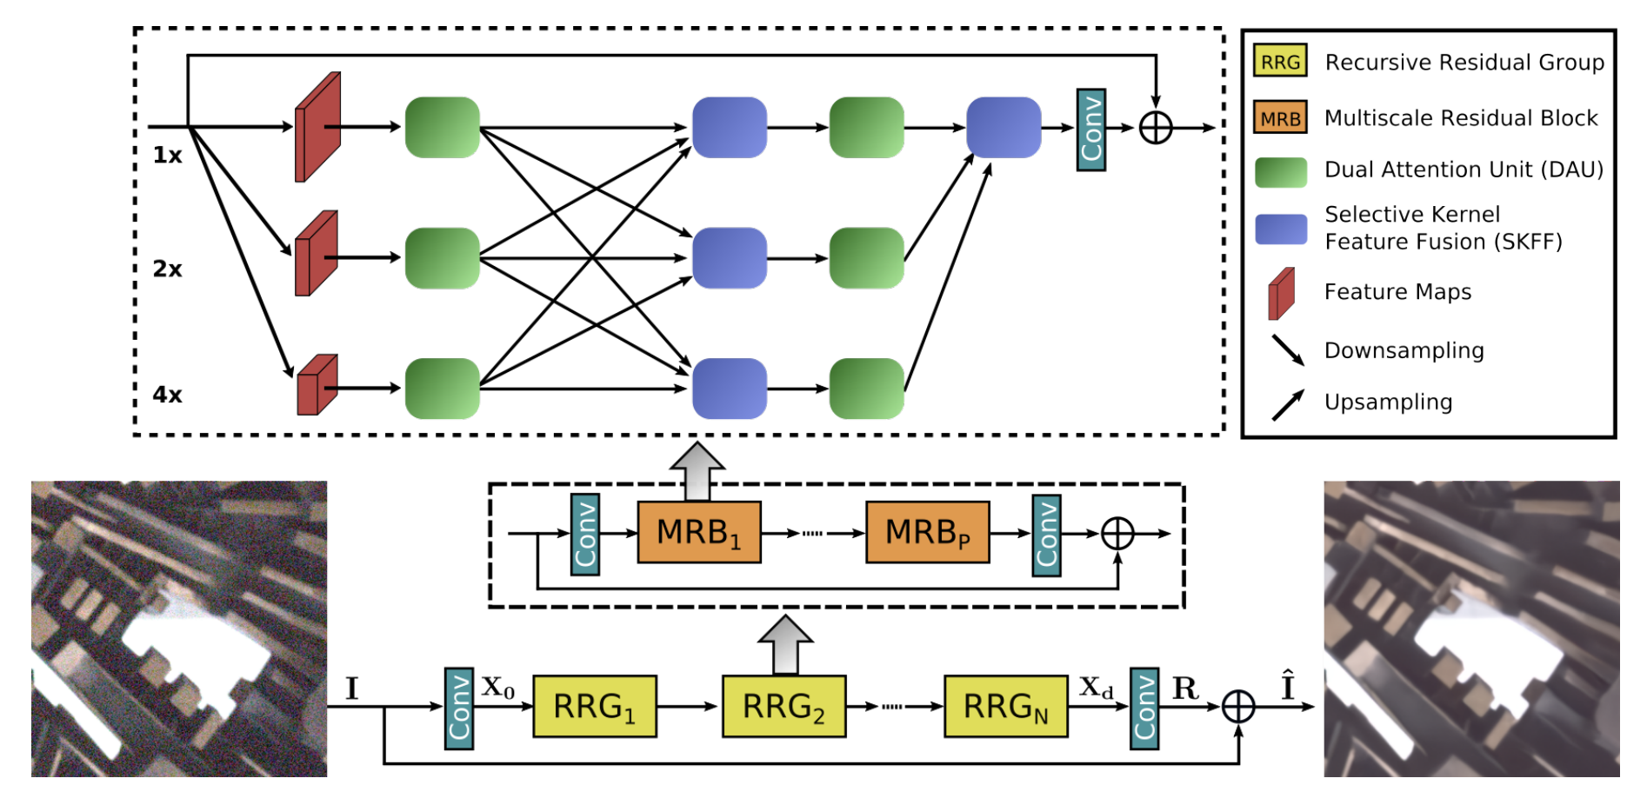
The figure above shows the framework of the proposed network MIRNet that learns enriched feature representations for image restoration and enhancement.

Slide 15
Colab file for MIRNet model
https://colab.research.google.com/drive/1IuPnXeO_cNkTyr2nc_fWNEYeakxcwPjL?usp=sharing

Slide 16
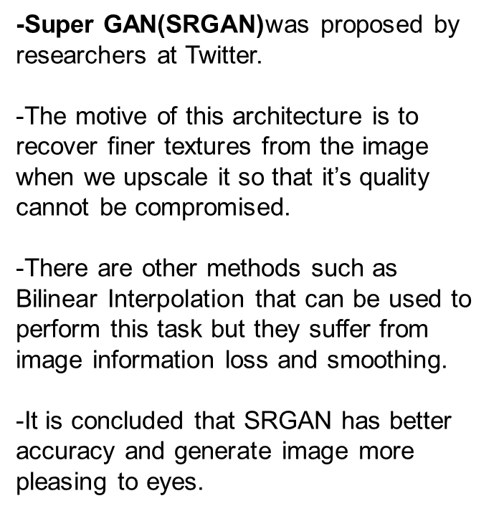
About SRGAN

Slide 17
Architecture
Similar to GAN architectures, the Super Resolution GAN also contains two parts:
Generator
Discriminator
Generator produces some data based on the probability distribution.
Discriminator tries to guess weather data coming from input dataset or generator.
Generator than tries to optimize the generated data so that it can fool the discriminator.

Slide 18
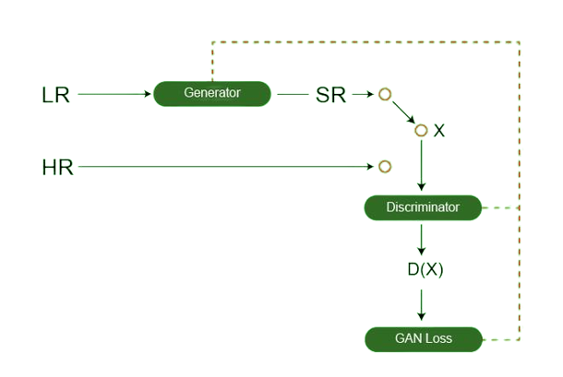
BASIC LAYOUT

Slide 19
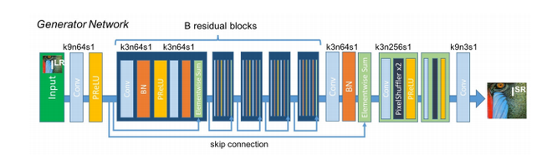
Generator Architecture
The generator architecture contains residual network instead of deep convolution networks because residual networks are easy to train and allows them to be substantially deeper in order to generate better results.
This is because the residual network used a type of connections called skip connections.

Slide 20
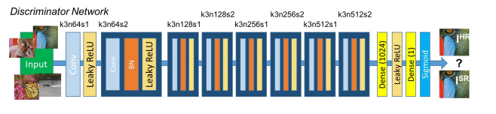
Discriminator Architecture
The task of the discriminator is to discriminate between real HR images and generated SR images. The network contains eight convolutional layers with of 3×3 filter kernels, increasing by a factor of 2 from 64 to 512 kernels.
Strided convolutions are used to reduce the image resolution each time the number of features is doubled.
The resulting 512 feature maps are followed by two dense layers and a leakyReLU applied between and a final sigmoid activation function to obtain a probability for sample classification.

Slide 21
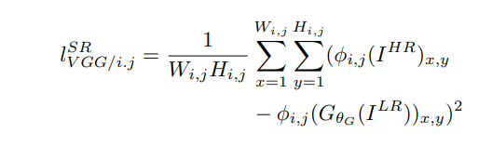
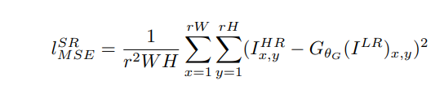
Loss Function:
The SRGAN uses perpetual loss function (L_{SR}) which is the weighted sum of two loss components : content loss and adversarial loss. This loss is very important for the performance of the generator architecture:
Content Loss: We use two types of content loss in this paper : pixelwise MSE loss for the SRResnet architecture, which is most common MSE loss for image Super Resolution. However MSE loss does not able to deal with high frequency content in the image that resulted in producing overly smooth images.This VGG loss is based on the ReLU activation layers of the pre-trained 19 layer VGG network. This loss is defined as follows:

Slide 22
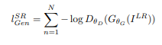
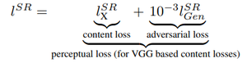
Loss Function
Adversarial Loss:
The Adversarial loss is the loss function that forces the generator to image more similar to high resolution image by using a discriminator that is trained to differentiate between high resolution and super resolution images.
Therefore total content loss of this architecture is:

Slide 23
THANK YOU

Slide 24
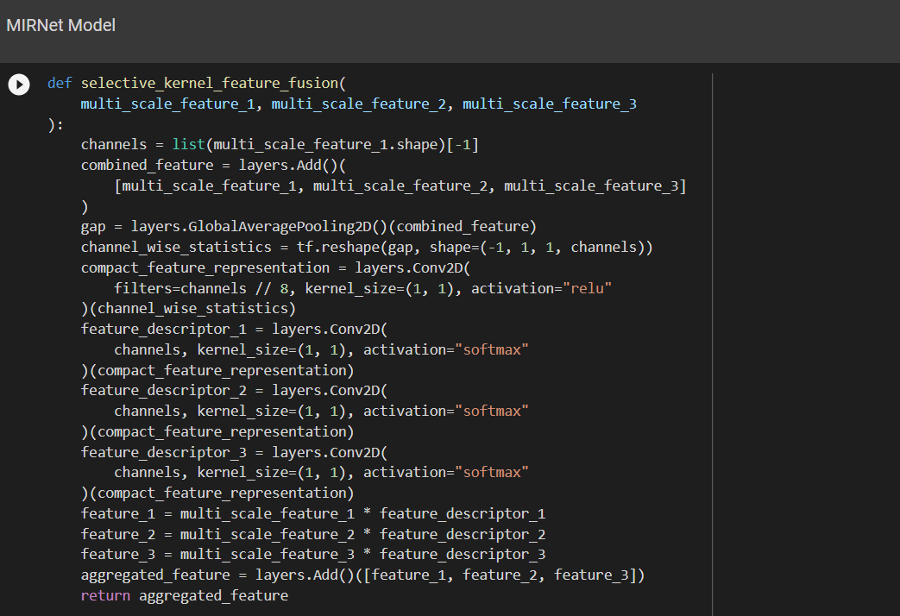
MIRNet kernal model

Slide 25
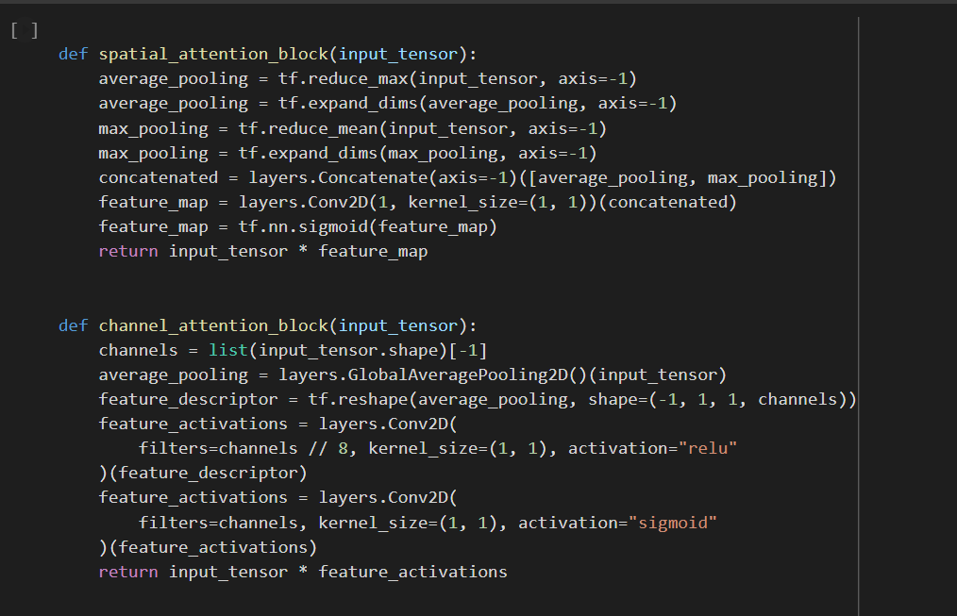
Special Attention and Channel Attention

Slide 26
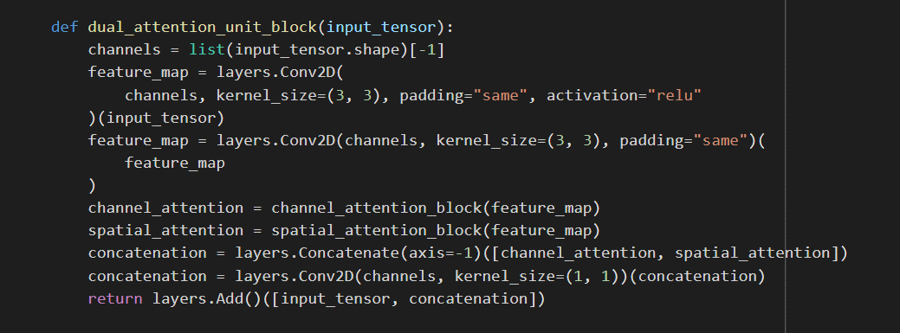
Dual Attention

Slide 27
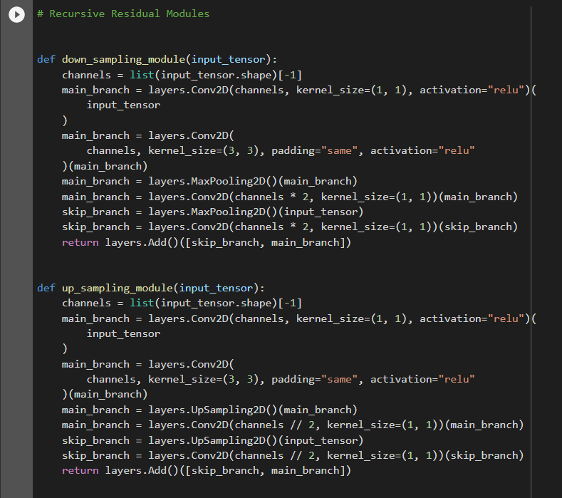
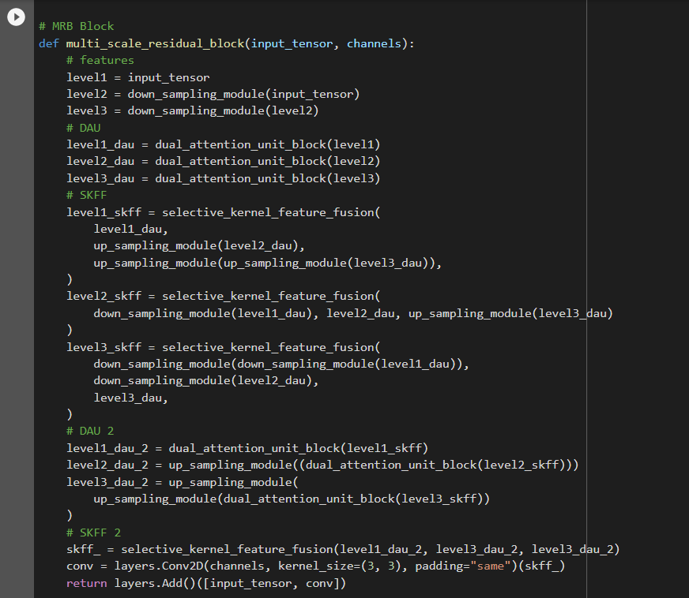
Multi-Scale Residual Block

Slide 28
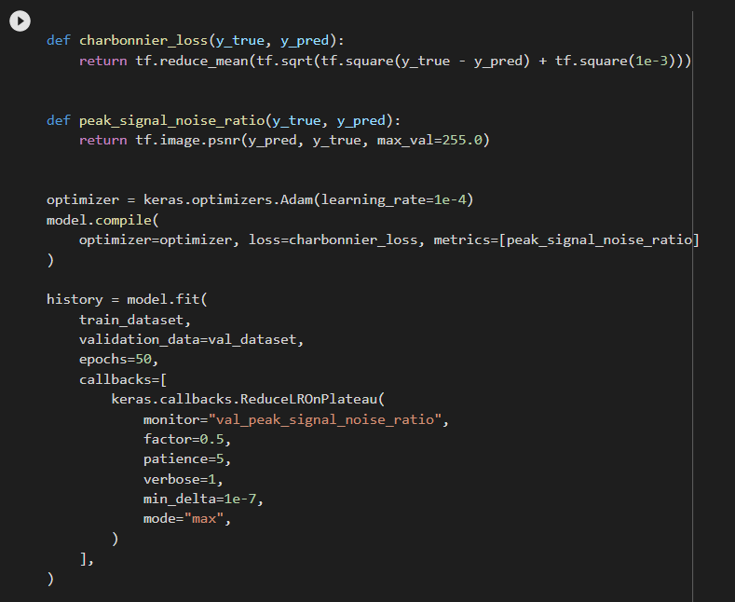
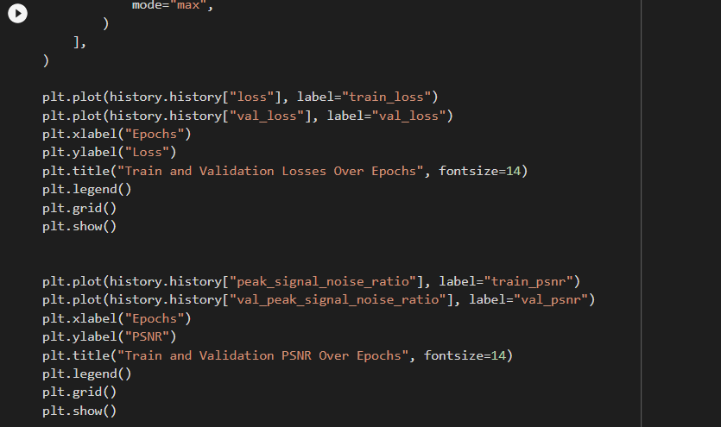
Training

Slide 29
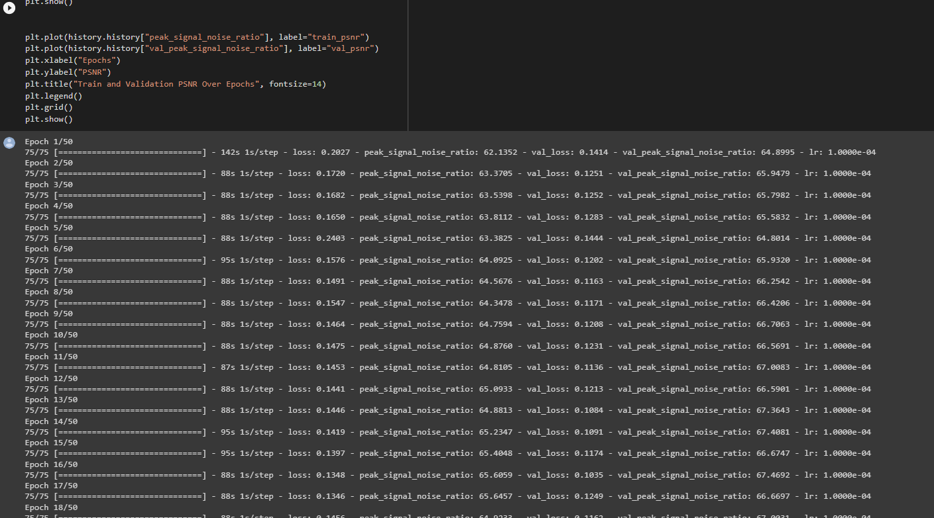

Slide 30
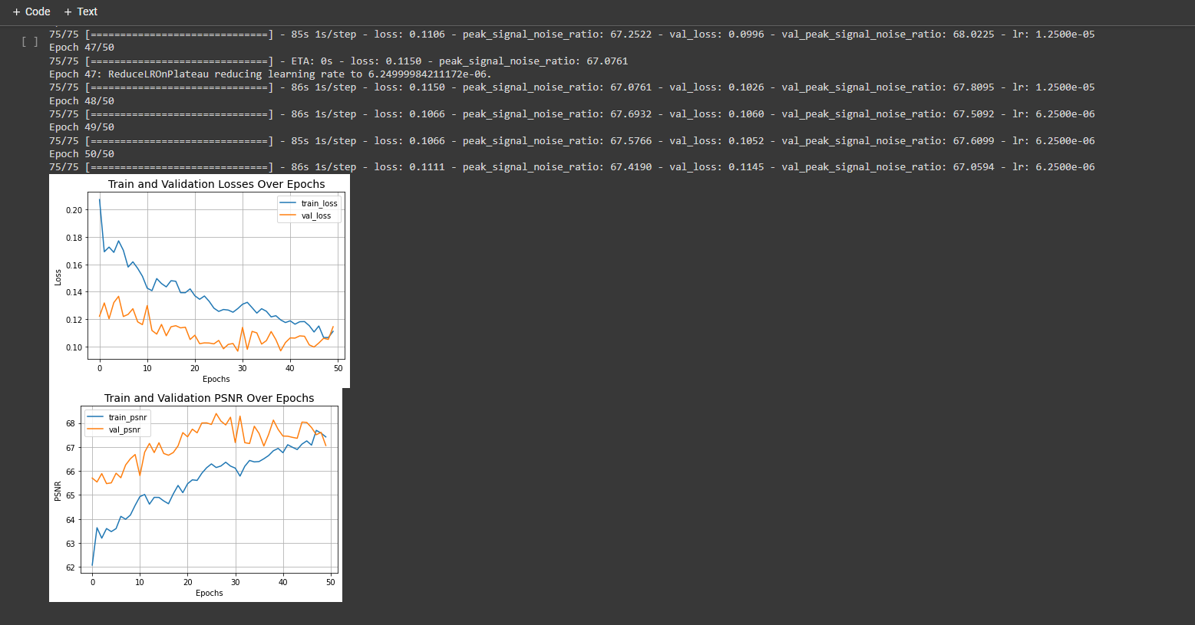

Slide 31
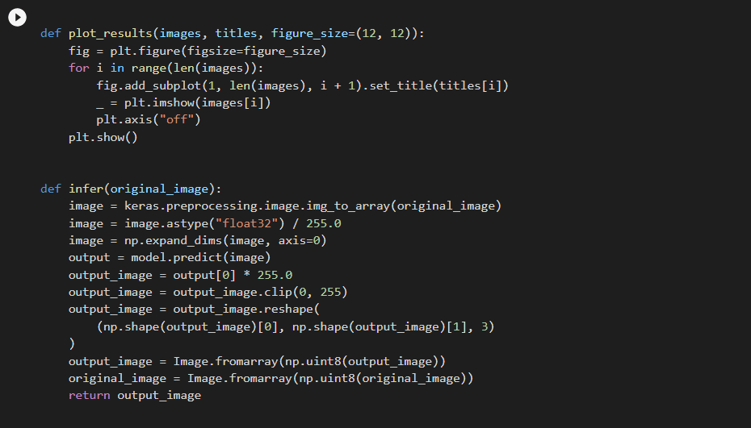
Inference

